Slide 1
Theory and Design of Network Security
Part I: Cryptography Basics and Public key Infrastructure
Unit 1: Block Cipher and Stream Cipher

Slide 2
Reference
William Stallings. Cryptography and Network Security: Principles and Practice (Fourth Edition). Prentice Hall, 2005.
B. A. Forouzan. Cryptography and Network Security. McGraw Hill, 2008.
David Hook. Beginning Cryptography with Java. Wiley Publishing Inc., 2005.

Slide 3
Block Cipher
Symmetric-key encipherment can be done using modern block ciphers.
Modes of operation have been devised to encipher text of any size employing either DES or AES.

Slide 4
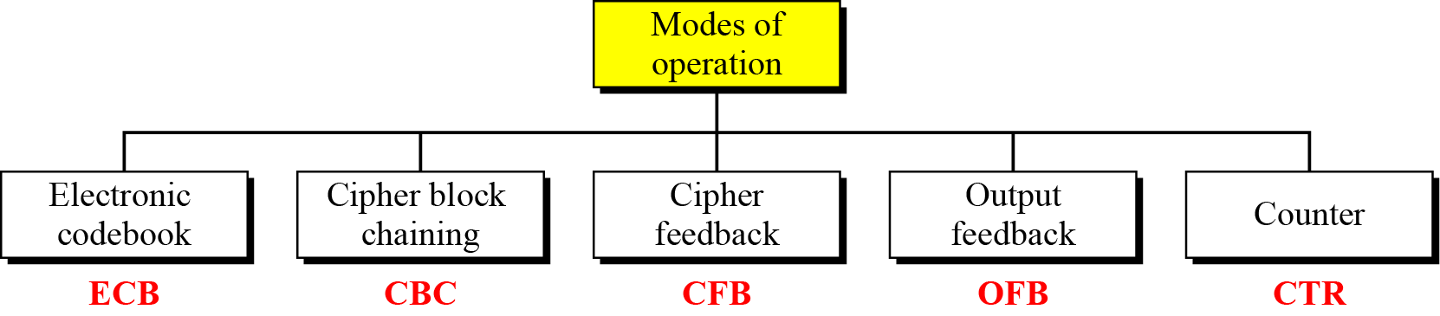
Modes of Operations

Slide 5
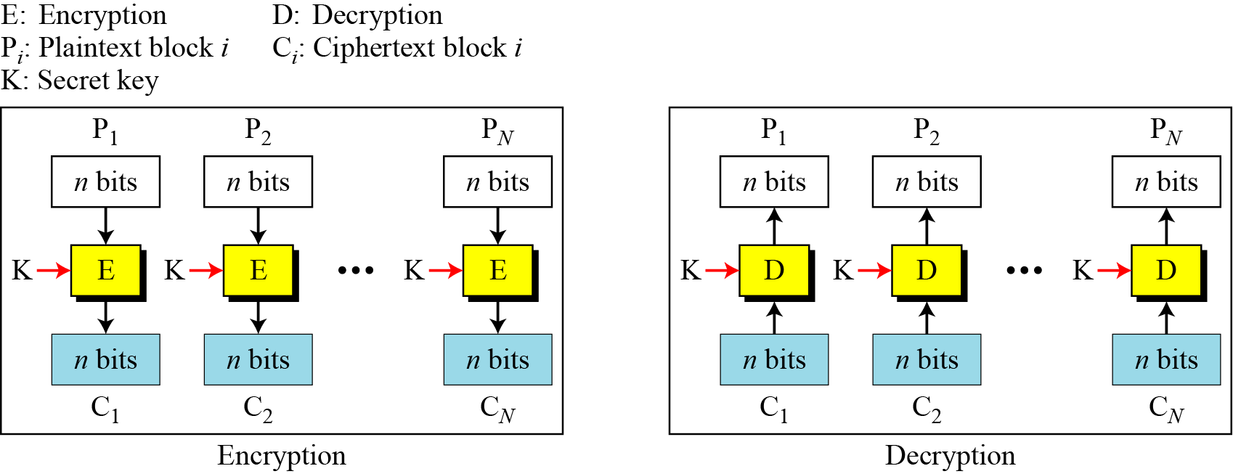
Electronic Codebook Mode (ECB)

Slide 6
Security Issues
Patterns at the block level are preserved. For example, equal blocks in the plaintext become equal blocks in the ciphertext. If Eve finds out that ciphertext blocks 1, 5, and 10 are the same, she knows that plaintext blocks 1, 5, and 10 are the same. This is a leak in security. For example, Eve can do an exhaustive search to decrypt only one of these blocks to find the contents of all of them.
The block independency creates opportunities for Eve to exchange some ciphertext blocks without knowing the key. For example, if she knows that block 8 always conveys some specific information, she can replace this block with the corresponding block in the previously intercepted message.

Slide 7
Error Propagation
A single bit error in transmission can create errors in several in the corresponding block. However, the error does not have any effect on the other blocks.

Slide 8
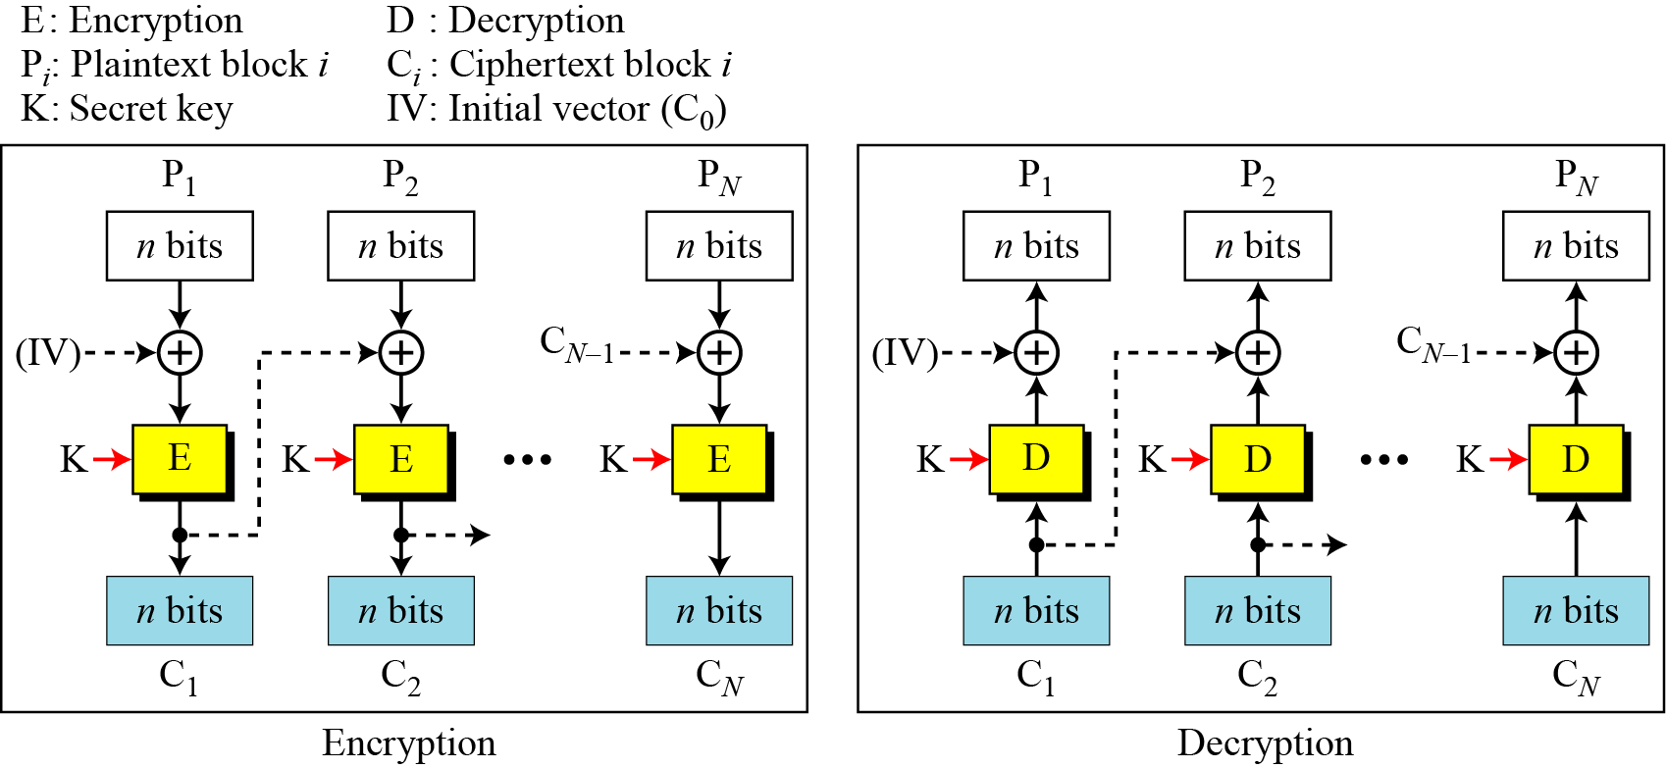
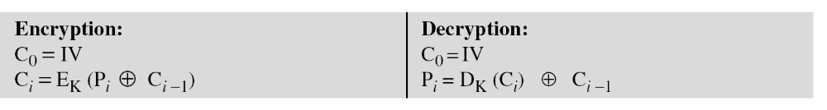
Cipher Block Chaining Mode
(CBC)

Slide 9
Initialization Vector (IV)
The initialization vector (IV) should be known by the sender and the receiver. Although keeping the vector secret is not necessary, the integrity of the vector plays an important role in the security of CBC mode; IV should be kept safe from change.
A pseudorandom number can be selected by the sender and transmitted through a secure channel (using ECB mode for example).

Slide 10
Security Issues
In CBC mode, equal plaintext blocks belonging to the same message are enciphered into different ciphertext blocks. In other words, the patterns at the block levels are not preserved. However, if two messages are equal, their encipherment is the same if they use the same IV. As a matter of fact, if the first M blocks in two different messages are equal, they are enciphered into equal blocks unless different IVs are used. For this reason, some people recommend the use of a timestamp as an IV.
Eve can add some ciphertext blocks to the end of the ciphertext stream.

Slide 11
Error Propagation
In CBC mode, a single bit error in ciphertext block C_{j} during transmission may create error in most bits in plaintext block P_{j} during decryption.
However, this single error toggles only one bit in plaintext block P_{j+1} (the bit in the same location).
Plaintext blocks P_{j+2} to P_{N} are not affected by this single bit error. A single bit error in ciphertext is self-recovered.

Slide 12
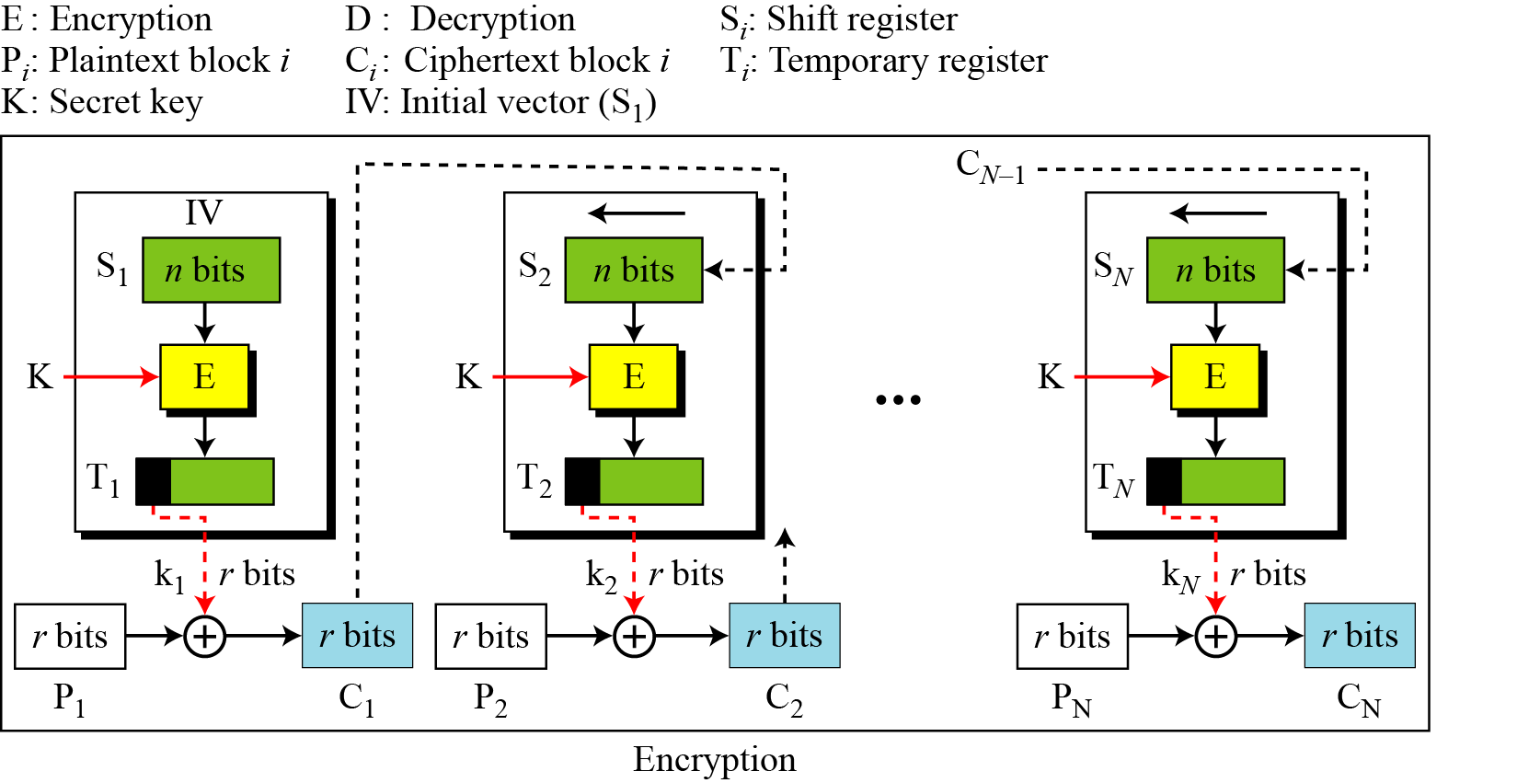
Cipher Feedback Mode (CFB)

Slide 13
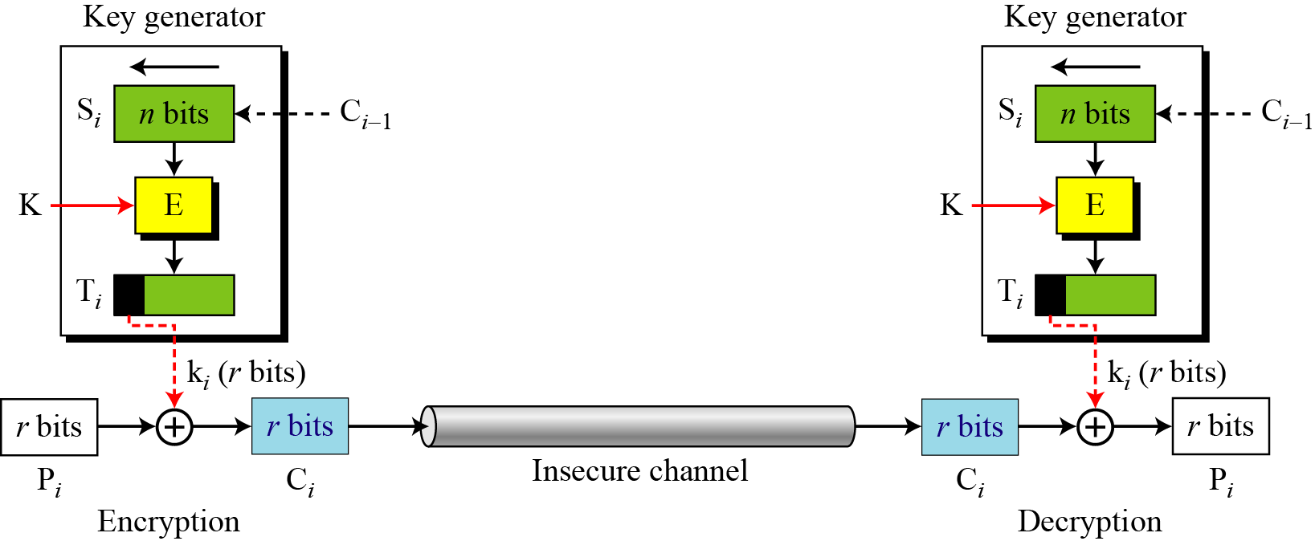
CFB as a Stream Cipher
Although CFB is an operation mode for using block ciphers such as DES or AES, the result is a stream cipher. In fact, it is a nonsynchronous stream cipher in which the key stream is dependent on the ciphertext.

Slide 14
Security Issues
Just like CBC, the patterns at the block level are not preserved.
More than one message can be encrypted with the same key, but the value of the IV should be changed for each message. This means that Alice needs to use a different IV each time she sends a message.
Eve can add some ciphertext block to the end of the ciphertext stream.

Slide 15
Error Propagation
In CFB, a single bit error in ciphertext block C_{j} during transmission creates a single bit error (at the same position) in plaintext block P_{j}.
However, most of the bits in the following plaintext blocks are in error (with 50 percent probability) as long as some bits of C_{j} are still in the shift register.
After the shift register is totally refreshed, the system recovers from the error.

Slide 16
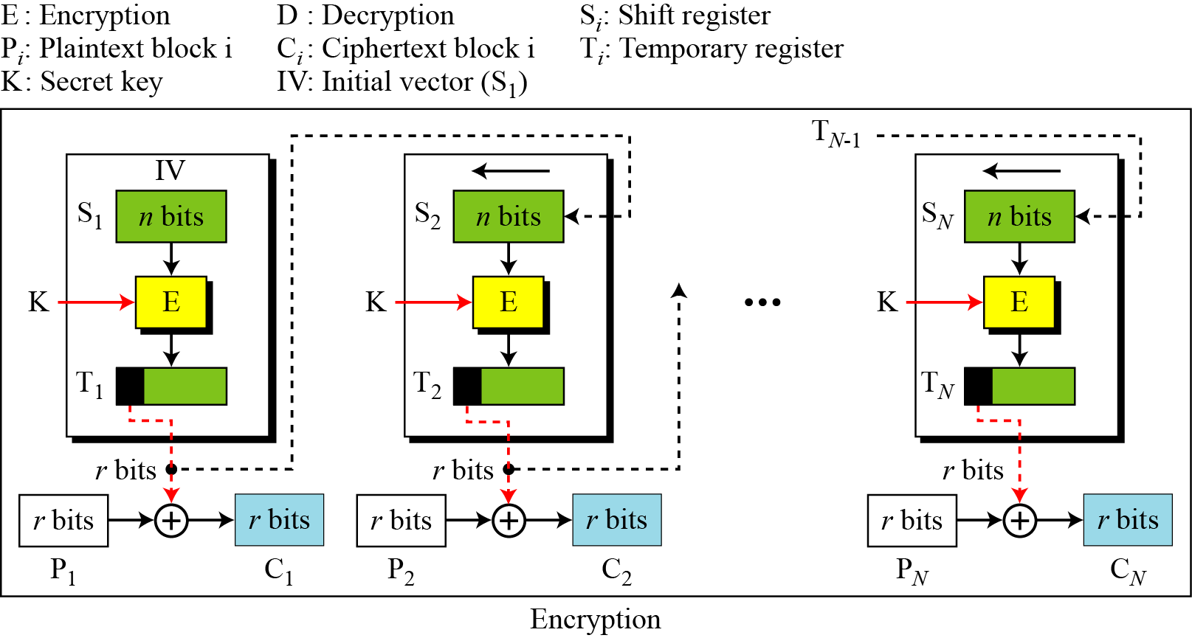
Output Feedback Mode (OFB)

Slide 17
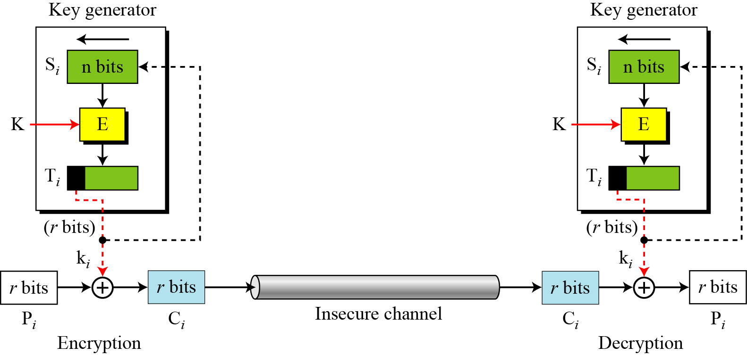
OFB as a Stream Cipher
The keystream, however, is independent from the plaintext or ciphertext, which means that the stream cipher is synchronous.

Slide 18
Security Issues and Error Propagation
Just like the CFB mode, patterns at the block level are not preserved.
Any change in the ciphertext affects the plaintext decrypted at the receiver side.
A single error in the ciphertext block c affects only the corresponding bit in the plaintext.

Slide 19
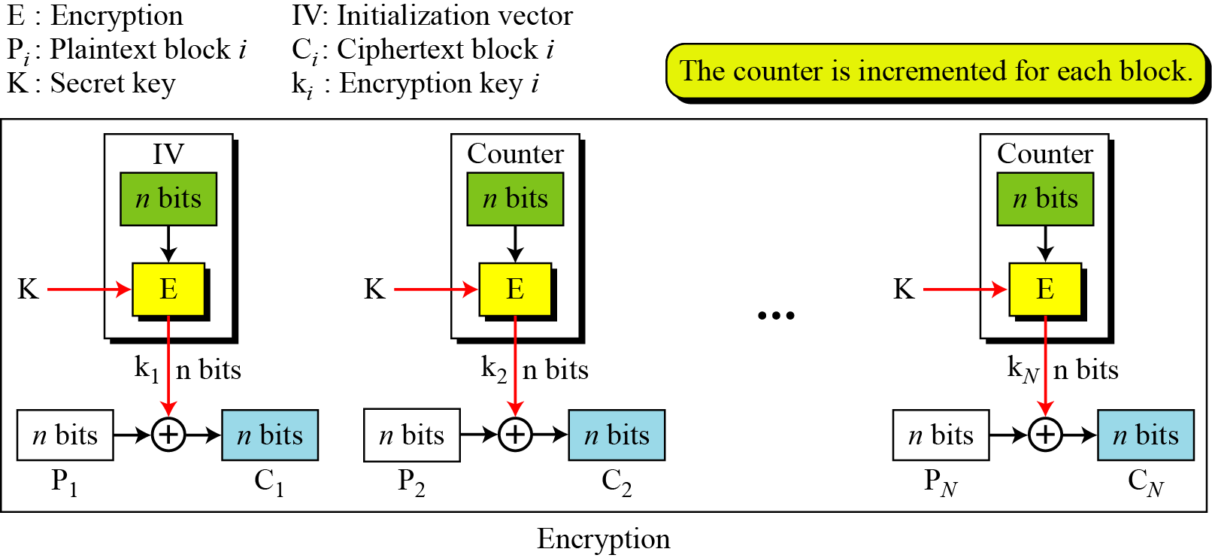
Counter Mode (CTR)

Slide 20
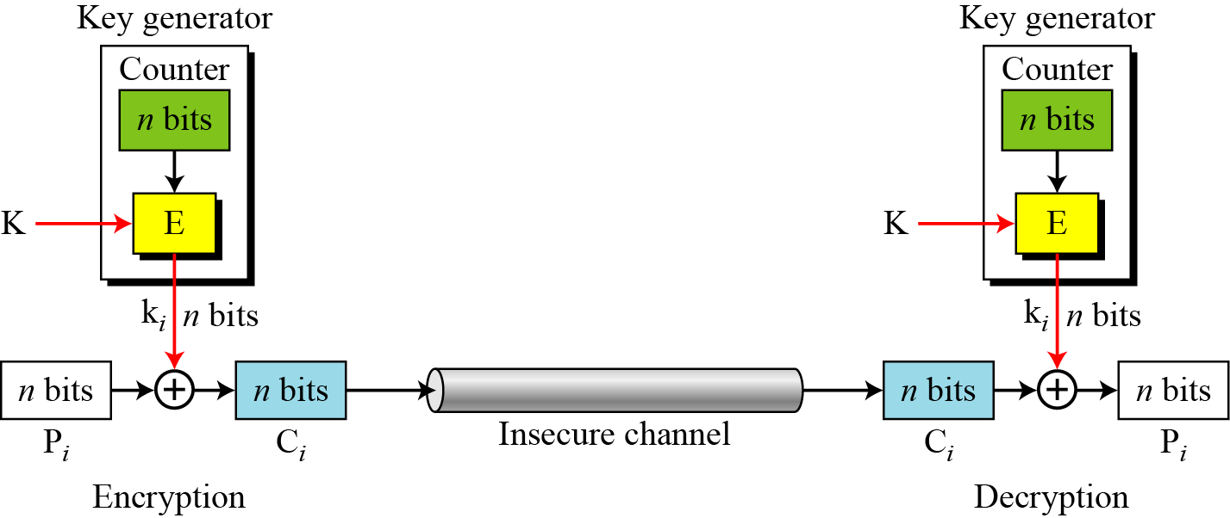
CTR as a Stream Cipher

Slide 21
Security Issues and Error Propagation
The security issues for the CTR mode are the same as the those for OFB mode.
A single error in the ciphertext affects only the corresponding bit in the plaintext.

Slide 22
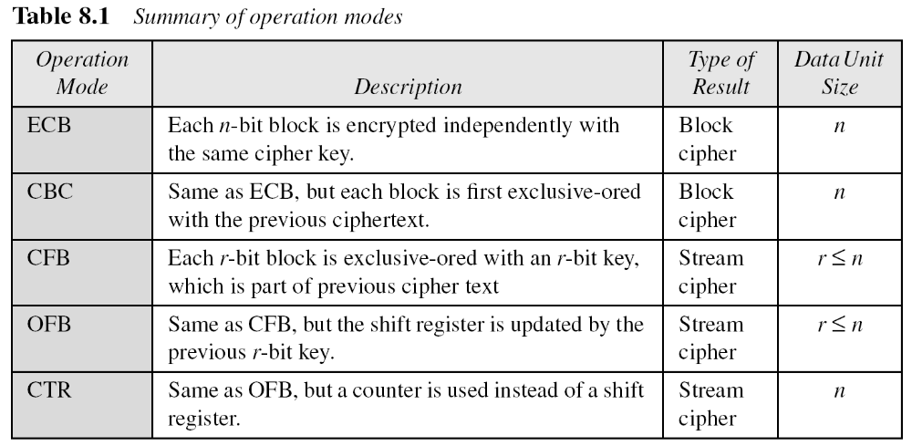
Comparison

Slide 23
Stream Cipher
RC4
  RC4 is a stream cipher that was designed in 1984 by Ronald Rivest for RSA Data Security.
  RC4 is used in many data communication and networking protocols, including SSL/TLS and the IEEE802.11 wireless LAN standard.

Slide 24
RC4
RC4 is a byte-oriented stream cipher in which a byte (8 bits) of a plaintext is exclusive-ored with a byte of key to produce a byte of a ciphertext.
State
  RC4 is based on the concept of a state.

Slide 25
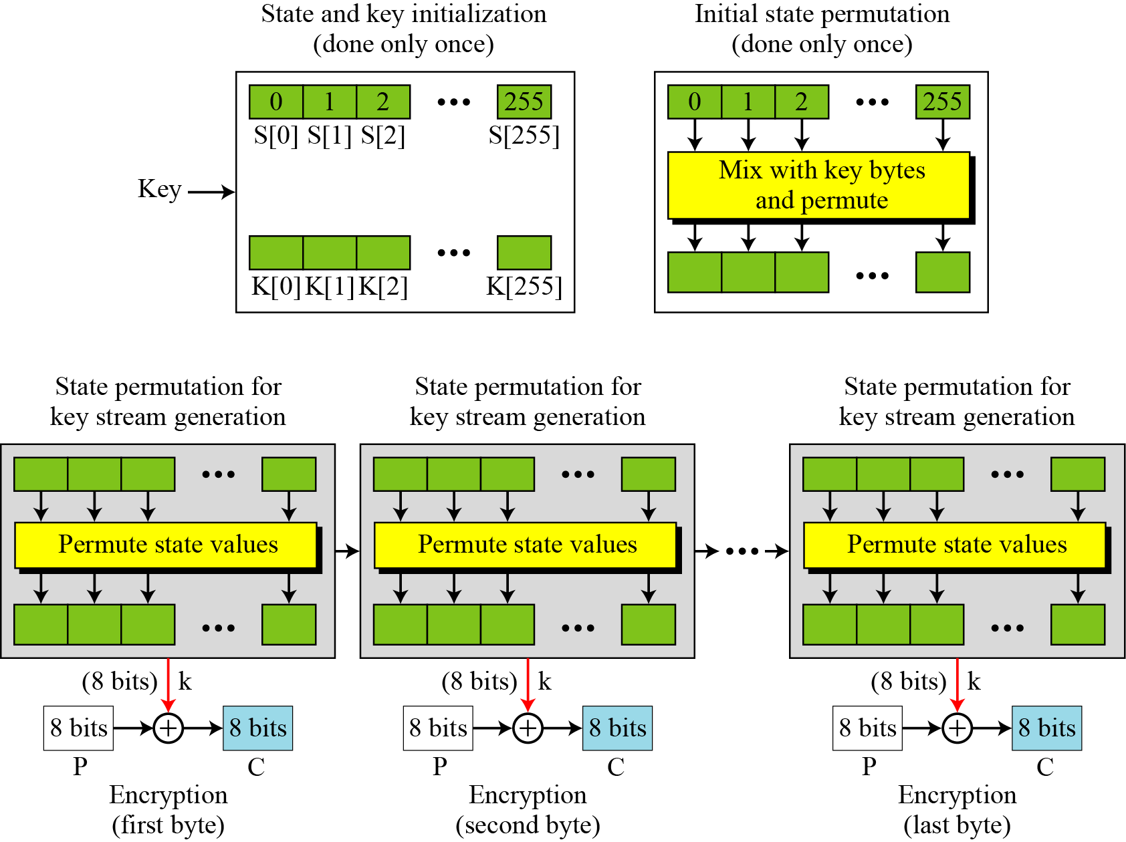
The Idea of RC4

Slide 26
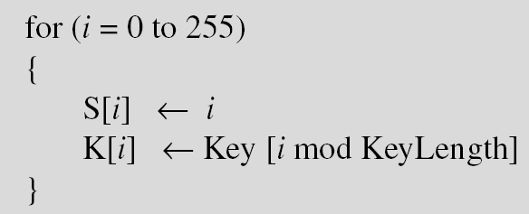
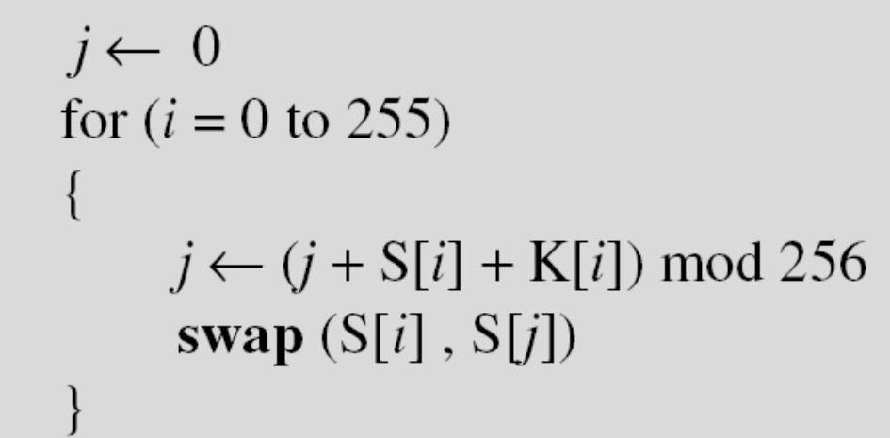
Initialization
Two steps

Slide 27
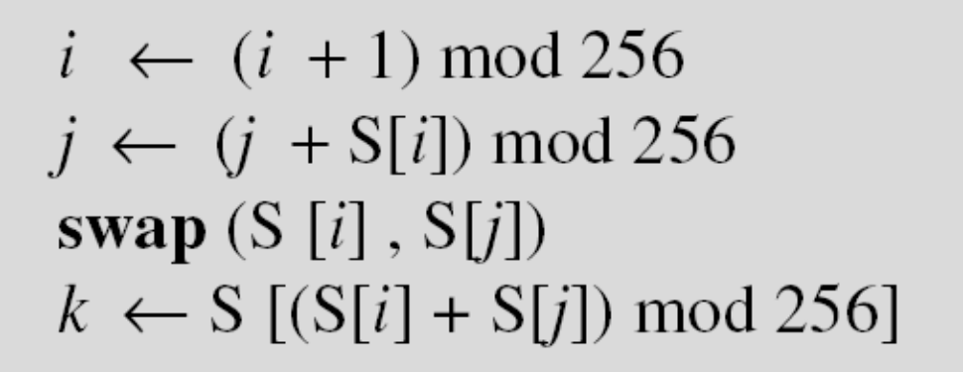
Key Stream Generation
while (more byte to encrypt)

Slide 28
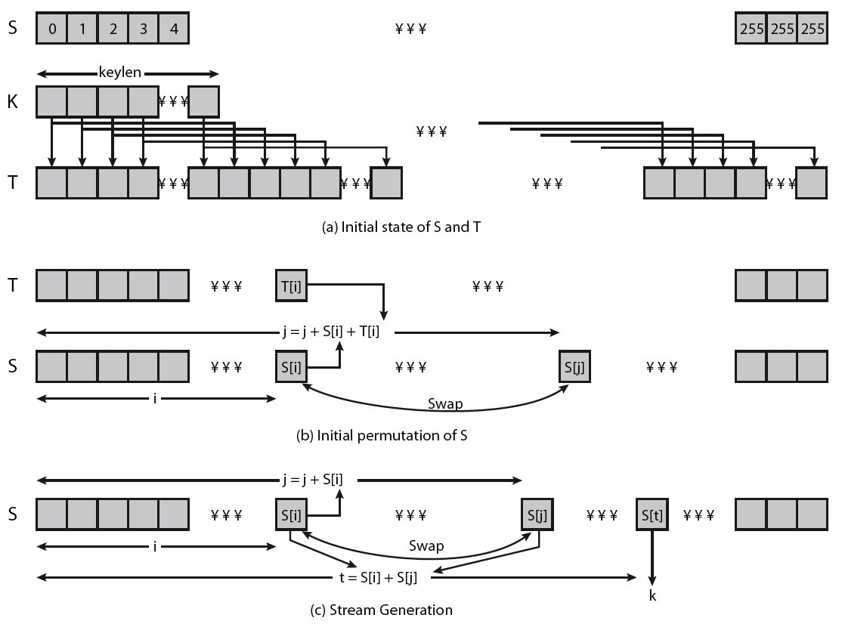
RC4 Overview
Notes:
Stallings Figure 6.9 illustrates the general structure of RC4.

Slide 29
Security Issues
It is believed that the cipher is secure if the key size is at least 128 bits (16 bytes).
There are some reported attacks for smaller key sizes (less than 5 bytes), but the protocols that use RC4 today all use key sizes that make RC4 secure.
However, like many other ciphers, it is recommended the different keys be used for different sessions. This prevents Eve from using differential cryptanalysis on the cipher.

Slide 30
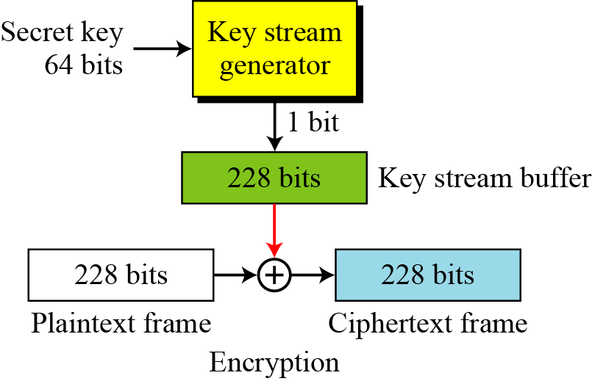
A5/1
A5/1 (a member of the A5 family of ciphers) is used in the Global System for Mobile Communication (GSM), a network for mobile telephone communication.

Slide 31
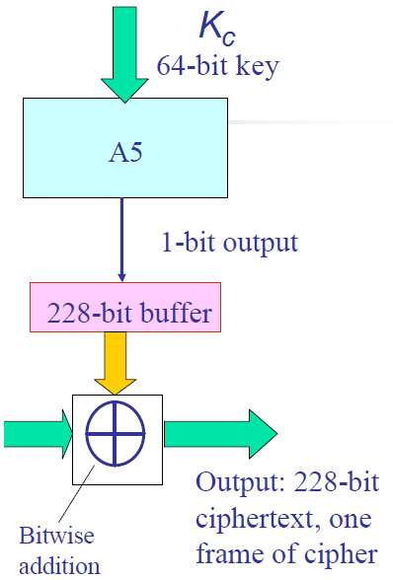
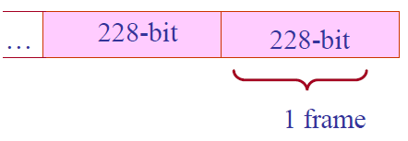
A5/1 and frames
GSM phone conversations: sequences of frames.
One 228 bit = frame is sent in 4.6 milliseconds: 114 bits for the communication in each direction.
A5/1 produces 228 bits to XOR with the plaintext in each frame

Slide 32
LFSR structure
b₁ | b₂ | b₃ | b₄ | ... | b_{n-1} | b_{n}
output
new value
Feedback Function : XOR
A5/1 based on Linear Feedback Shift Registers: LFSRs
Purpose - to produce pseudo random bit sequence
Consists of two parts :
  shift register – bit sequence
  feedback function
Tap Sequence :
  bits that are input to the feedback function

Slide 33
LFSR Features
LFSR Period – the length of the output sequence before it starts repeating itself.
n-bit LFSR can be in 2^{n}-1 internal states
➔ the maximal period is also 2^{n}-1
the tap sequence determines the period
the polynomial formed by a tap sequence plus 1 must be a primitive polynomial (mod 2)
Notes:
What is primitive polynomial?
Boolean polynomial p(x) that can be used to compute the increasing powers of n of x^n mod p(x), to obtain all possible non-zero polynoomials of degree less than p(x)

Slide 34
LFSR Example
Example :
x¹²+x⁶+x⁴+x+1 corresponds to LFSR of length 12
b₁ | b₂ | b₃ | b₄ | b₅ | b₆ | b₇ | b₈ | b₉ | b₁₀ | b₁₁ | b₁₂

Slide 35
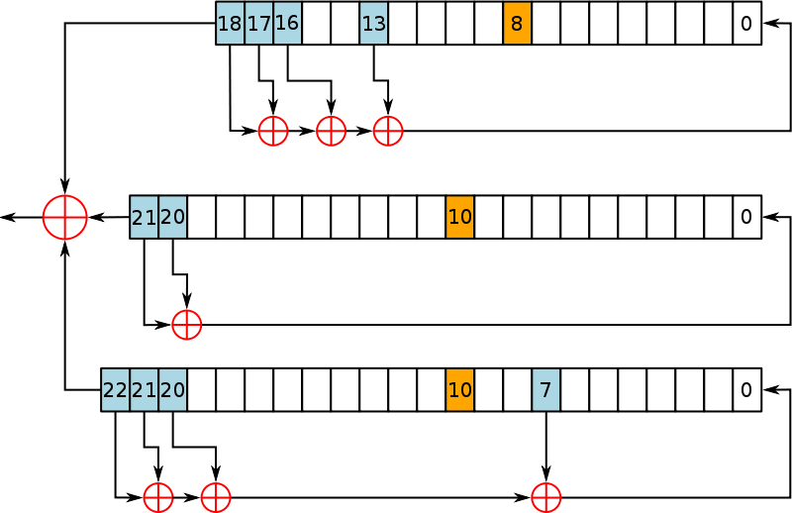
A5/1 LFSRs
Consists of 3 LFSRs of different lengths
19 bits
  x¹⁸ + x¹⁷ + x¹⁶ + x¹³ + 1
  clock bit 8
  tapped bits: 13, 16, 17, 18
22 bits
  x²¹ + x²⁰ + 1
  clock bit 10
  tapped bits 20, 21
23 bits
  x²² + x²¹ + x²⁰ + x⁷ + 1
  clock bit 10
  tapped bits 7, 20, 21, 22
Notes:
Least significant bit numbered 0
Tapped bits of each LSRF are XORed to create value of next 0 bit.
Output bits of the three LSRFs are XORed to form the keystream bit

Slide 36
A5/1 : Operation
All 3 registers are zeroed
64 cycles (without the stop/go clock) :
  Each bit of K_{c}(lsb to msb) is XOR'ed in parallel into the lsb's of the registers
22 cycles (without the stop/go clock) :
  Each bit of F_{n} (lsb to msb) is XOR'ed in parallel into the lsb's of the registers
100 cycles with the stop/go clock control, discarding the output
228 cycles with the stop/go clock control which produce the output bit sequence.
Notes:
Registers set to all 0’s
Incorporate the key and frame number:
For 64 cycles, the key is mixed in by XORing the ith key bit with the least significant bit of each register
For 22 cycles, the 22 bit frame value is mixed in – same as with key value
Normal clocking used
100 cycles are run using the majority clocking, the output is discarded
End result is the initial state

Slide 37
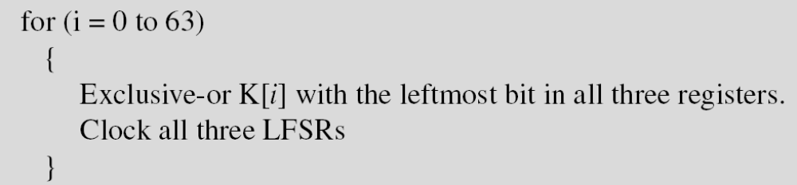
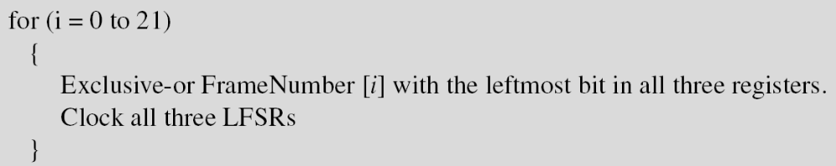
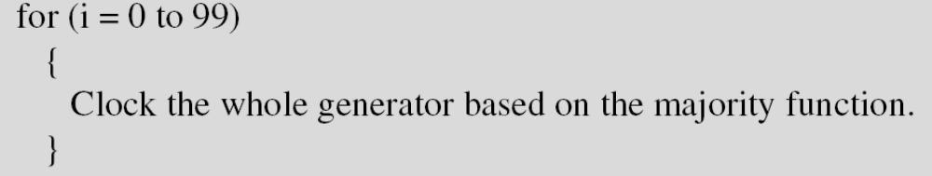
Initialization
Set all bits in three LFSRs to 0.

Slide 38
A5/1 working example
18
17
16
0
0 | 1 | 1 | 1 | 1 | 0 | 1 | 1 | 0 | 1 | 0 | 1 | 1 | 0 | 1 | 0 | 1 | 0
1
1 | 1 | 1 | 1 | 0 | 1 | 1 | 0 | 1 | 0 | 1 | 1 | 0 | 1 | 0 | 1 | 0 | 1
1 | 0 | 1 | 1 | 1 | 1 | 0 | 1 | 1 | 0 | 1 | 0 | 1 | 1 | 0 | 1 | 0 | 1 | 0
0
R1
C1
1
0
clock
control
21
20
0
1 | 0 | 1 | 1 | 1 | 0 | 0 | 1 | 0 | 0 | 1 | 0 | 1 | 0 | 1 | 0 | 1 | 1 | 1 | 0 | 0 | 1
1
1
1
0 | 1 | 1 | 1 | 0 | 0 | 1 | 0 | 0 | 1 | 0 | 1 | 0 | 1 | 0 | 1 | 1 | 1 | 0 | 0 | 1
R2
C2
1
22
21
20
0
0 | 1 | 0 | 1 | 0 | 1 | 0 | 0 | 1 | 1 | 0 | 1 | 1 | 1 | 0 | 1 | 1 | 0 | 0 | 1 | 0 | 1
1 | 0 | 1 | 0 | 1 | 0 | 1 | 0 | 0 | 1 | 1 | 0 | 1 | 1 | 1 | 0 | 1 | 1 | 0 | 0 | 1 | 0 | 1
0
R3
C3
0

Slide 39
Security of A5/1
As leakage from the algorithm many cryptanalysis works are performed.
  Known-plaintext attacks
  Directly to the GSM networks

